Slide 1

Counting; Summing; Min/max loops
Python Programming | Loops, string, files, list, dictionaries and tuples
Course: Python Programming | Chapter: Loops, string, files, list, dictionaries and tuples | Program: Bachelor of Computer Science and Engineering
DISCOVER · LEARN · EMPOWER
Notes:
Welcome everyone to today's session on advanced loop operations. We will focus specifically on counting, summing, and finding minimum or maximum values within data structures. These are fundamental patterns you will use in every real-world Python application you build. Let's dive into how to implement these efficiently.

Slide 2
Course Outcomes
SLIDE 2 / 14
Course Outcome
CO | BT LEVEL | DESCRIPTION
CO1 | BT1 | Understand the syntax, control structures, and basic constructs of Python programming language
CO2 | BT3 | Apply functions, modules, and exception handling for modular program development
CO3 | BT3 | Implement data structures including lists, tuples, dictionaries, and sets for efficient data processing
CO4 | BT4 | Analyze and manipulate files, strings, and perform data handling operations
CO5 | BT5 | Design and develop real-world applications integrating multiple Python concepts
Chandigarh University
2 / 14
Notes:
Today's lecture directly addresses two specific course outcomes. First, we will analyze how to manipulate data using loops to handle files and strings effectively. Second, we will design logic that integrates these concepts to build robust applications. These skills are essential for your engineering projects.

Slide 3
Learning Objectives
SLIDE 3 / 14
Learning Outcomes
1
Analyze the logic behind initializing counters for iterative counting operations.
2
Evaluate the efficiency of summing algorithms for large numeric datasets.
3
Construct loops to identify minimum and maximum values dynamically.
4
Apply these patterns to process lists, tuples, and dictionary values.
5
Critique common pitfalls like off-by-one errors in loop bounds.
Chandigarh University
3 / 14
Notes:
By the end of this session, you will be able to analyze how counters work under the hood. You will evaluate different approaches to summing data and construct loops that find min and max values without built-in functions. We will also apply these patterns to various data structures like lists and tuples.

Slide 4
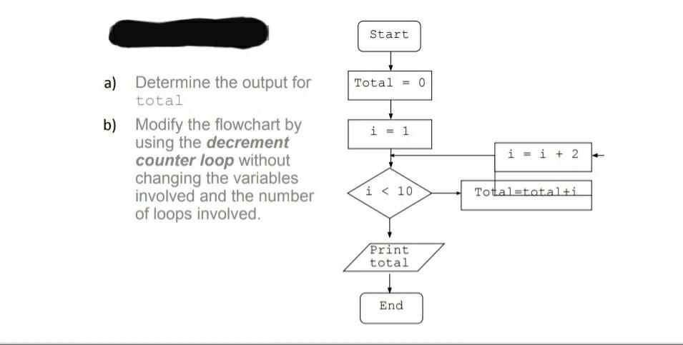
Lecture
SLIDE 4 / 14
Counting Logic and Initialization
1
Initialize a counter variable to zero before starting the loop iteration.
2
Increment the counter by one for every valid item processed in the loop.
3
The final counter value represents the total number of items found.
4
Use a boolean flag to count items meeting specific conditional criteria.
5
Counting is essential for calculating averages and percentages later in analysis.
Solved Start Total = 0 i = 1 a) Determine the output for | Chegg.com
Chandigarh University
4 / 14
Notes:
Think of a counter like a tally mark on a piece of paper. You must start at zero; if you forget this, your results will be garbage. For example, if you count students in a class, you start with zero and add one for each student you see. This simple logic forms the basis of all frequency analysis.

Slide 5

Lecture
SLIDE 5 / 14
Summing Numeric Sequences
1
Initialize a sum accumulator variable to zero before the loop begins.
2
Add the current item value to the accumulator in each iteration.
3
The final accumulator value holds the total sum of all elements.
4
Summing is required to calculate mean, variance, and other statistical metrics.
5
Accumulators can also sum specific conditions like positive numbers only.
Source: ecdn.teacherspayteachers.com
Chandigarh University
5 / 14
Notes:
Summing is like pouring water into a bucket drop by drop. You start with an empty bucket, which is zero, and add each number as you encounter it. If you have a list of test scores, you sum them to find the total points available. This is a critical step before calculating the average score.

Slide 6
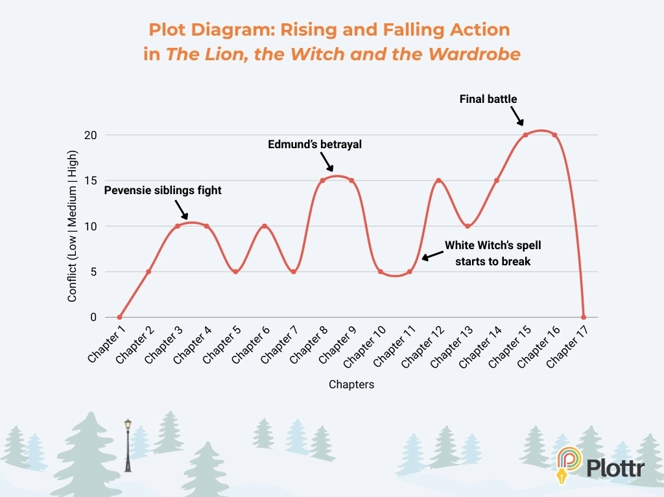
Lecture
SLIDE 6 / 14
Finding Minimum Values
1
Initialize the minimum tracker with the first element of the sequence.
2
Compare each subsequent element against the current minimum value.
3
Update the tracker if the new element is strictly smaller than current.
4
This logic works for lists, tuples, and dictionary values effectively.
5
Handling empty sequences requires a specific check before starting the loop.
Source: plottr.com
Chandigarh University
6 / 14
Notes:
To find the minimum, imagine you are holding the lowest score you have seen so far. You start by assuming the first student has the lowest score. As you check others, if someone scores lower, you update your record. This ensures you always hold the absolute lowest value found.

Slide 7
Lecture
SLIDE 7 / 14
Finding Maximum Values
1
Initialize the maximum tracker with the first element of the sequence.
2
Compare each subsequent element against the current maximum value.
3
Update the tracker if the new element is strictly larger than current.
4
This logic is symmetric to finding minimum values in any dataset.
5
Useful for identifying peak performance or highest temperature readings.
Chandigarh University
7 / 14
Notes:
Finding the maximum is the mirror image of finding the minimum. You start with the first value as your current highest. As you iterate, if you find a value higher than your current record, you update it. This is crucial for identifying peak loads in engineering systems or highest scores in a class.

Slide 8
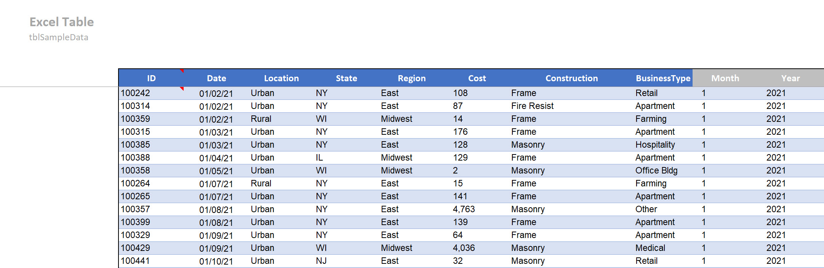
Worked Example
SLIDE 8 / 14
Counting
GOVERNING EQUATION
Initialize count = 0 before the loop starts processing
PROBLEM
Count how many numbers in a list are greater than 50.
DATA
[12, 55, 30, 88, 45, 92, 10, 60].
LOOP THROUGH LIST
if item > 50, increment count by 1.
RESULT
Items 55, 88, 92, 60 match; final count is 4.
Source: www.excelandaccess.com
Chandigarh University
8 / 14
Notes:
Let's walk through a concrete example. We have a list of numbers and want to count those above 50. We start with a count of zero. When we see 55, we add one. When we see 30, we do nothing. By the end, we have counted four items that met our condition. This is how we filter data.

Slide 9
Worked Example
SLIDE 9 / 14
Summing
GOVERNING EQUATION
Initialize total_sum = 0 before the loop iteration begins
PROBLEM
Calculate the sum of all even numbers in a list.
DATA
[1, 2, 3, 4, 5, 6, 7, 8, 9, 10].
LOOP
if item % 2 == 0, add item to total_sum.
CALCULATION
2 + 4 + 6 + 8 + 10 = 30.
Chandigarh University
9 / 14
Notes:
Now let's sum the even numbers from our list. We start with a total of zero. We check each number; if it is divisible by two, we add it to our running total. We add 2, then 4, then 6, and so on. The final result is 30, which is the sum of all even numbers in that range.

Slide 10
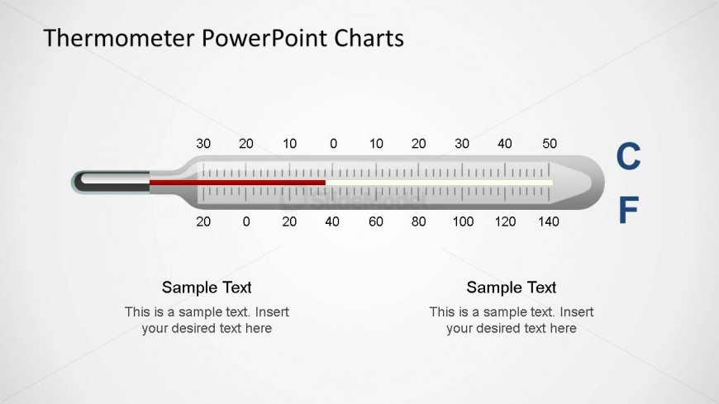
Worked Example
SLIDE 10 / 14
Min/Max
GOVERNING EQUATION
Initialize min_temp = 22 and max_temp = 22 initially
PROBLEM
Find the minimum and maximum temperature in a week.
DATA
[22, 25, 21, 28, 24, 23, 26] degrees Celsius.
ITERATE
update min if value < current min, max if value > current.
RESULT
Minimum is 21, Maximum is 28 degrees Celsius.
Source: slidemodel.com
Chandigarh University
10 / 14
Notes:
Consider a week of temperature readings. We start by assuming the first day's temperature is both the min and max. As we check the rest, we see 21 is lower, so we update the minimum. We see 28 is higher, so we update the maximum. This gives us the full range of temperatures recorded.

Slide 11
Common Pitfall
SLIDE 11 / 14
Initialization
1
Failing to initialize variables leads to undefined behavior or errors.
2
Using a non-zero start value for counting causes incorrect totals.
3
Starting min/max with zero instead of the first data element fails.
4
Always initialize with the first element for min/max logic.
5
Zero is safe for counting and summing but not for min/max.
Chandigarh University
11 / 14
Notes:
A very common mistake is forgetting to initialize your variables. If you try to find a minimum without setting the first value, your logic breaks. For counting and summing, zero is the correct start. But for min and max, you must start with the first actual data point to ensure accuracy.

Slide 12
Common Pitfall
SLIDE 12 / 14
Off-by-One
1
Incorrect loop bounds can skip the first or last element.
2
Using range(len(list)) is safer than hard-coded indices.
3
Off-by-one errors result in missing data or index out of bounds.
4
Always verify loop conditions when iterating over complex structures.
5
Test with small datasets to catch boundary errors early.
Chandigarh University
12 / 14
Notes:
Another frequent error is the off-by-one mistake. This happens when your loop stops one step too early or goes one step too far. You might miss the last item in your list or crash your program. Always double-check your loop conditions, especially when using indices manually.

Slide 13
Lecture
SLIDE 13 / 14
Key Takeaways
1
Initialize counters and accumulators to zero before starting any loop.
2
Initialize min/max trackers with the first element of the data.
3
Use conditional logic inside loops to filter items for counting or summing.
4
Always verify loop bounds to prevent off-by-one errors.
5
These patterns are essential for data analysis and file processing tasks.
Chandigarh University
13 / 14
Notes:
To summarize, always initialize your variables correctly before the loop starts. Remember that min and max need the first data point, not zero. Use conditions inside your loops to filter data for counting or summing. Finally, always check your loop bounds to avoid skipping data.

Slide 14
Lecture
SLIDE 14 / 14
References
PYTHON
A Practical Learning Approach, 1st Edition — T.S. Murugesh, Shriram K. Vasudevan, Sini Raj Pulari
• Learning Python, 6th Edition — Mark Lutz
• Starting Out with Python, Global Edition, 6th Edition — Tony Gaddis
• Introduction to Python Programming and Data Structures, 3rd Edition — Y. Daniel Liang
Chandigarh University
14 / 14
Notes:
For further reading, I recommend these four textbooks. They provide deep insights into Python programming and data structures. Mark Lutz and Tony Gaddis offer excellent foundational knowledge. The other two books provide practical approaches suitable for engineering students. Please refer to them for more complex examples.

